Slide 1
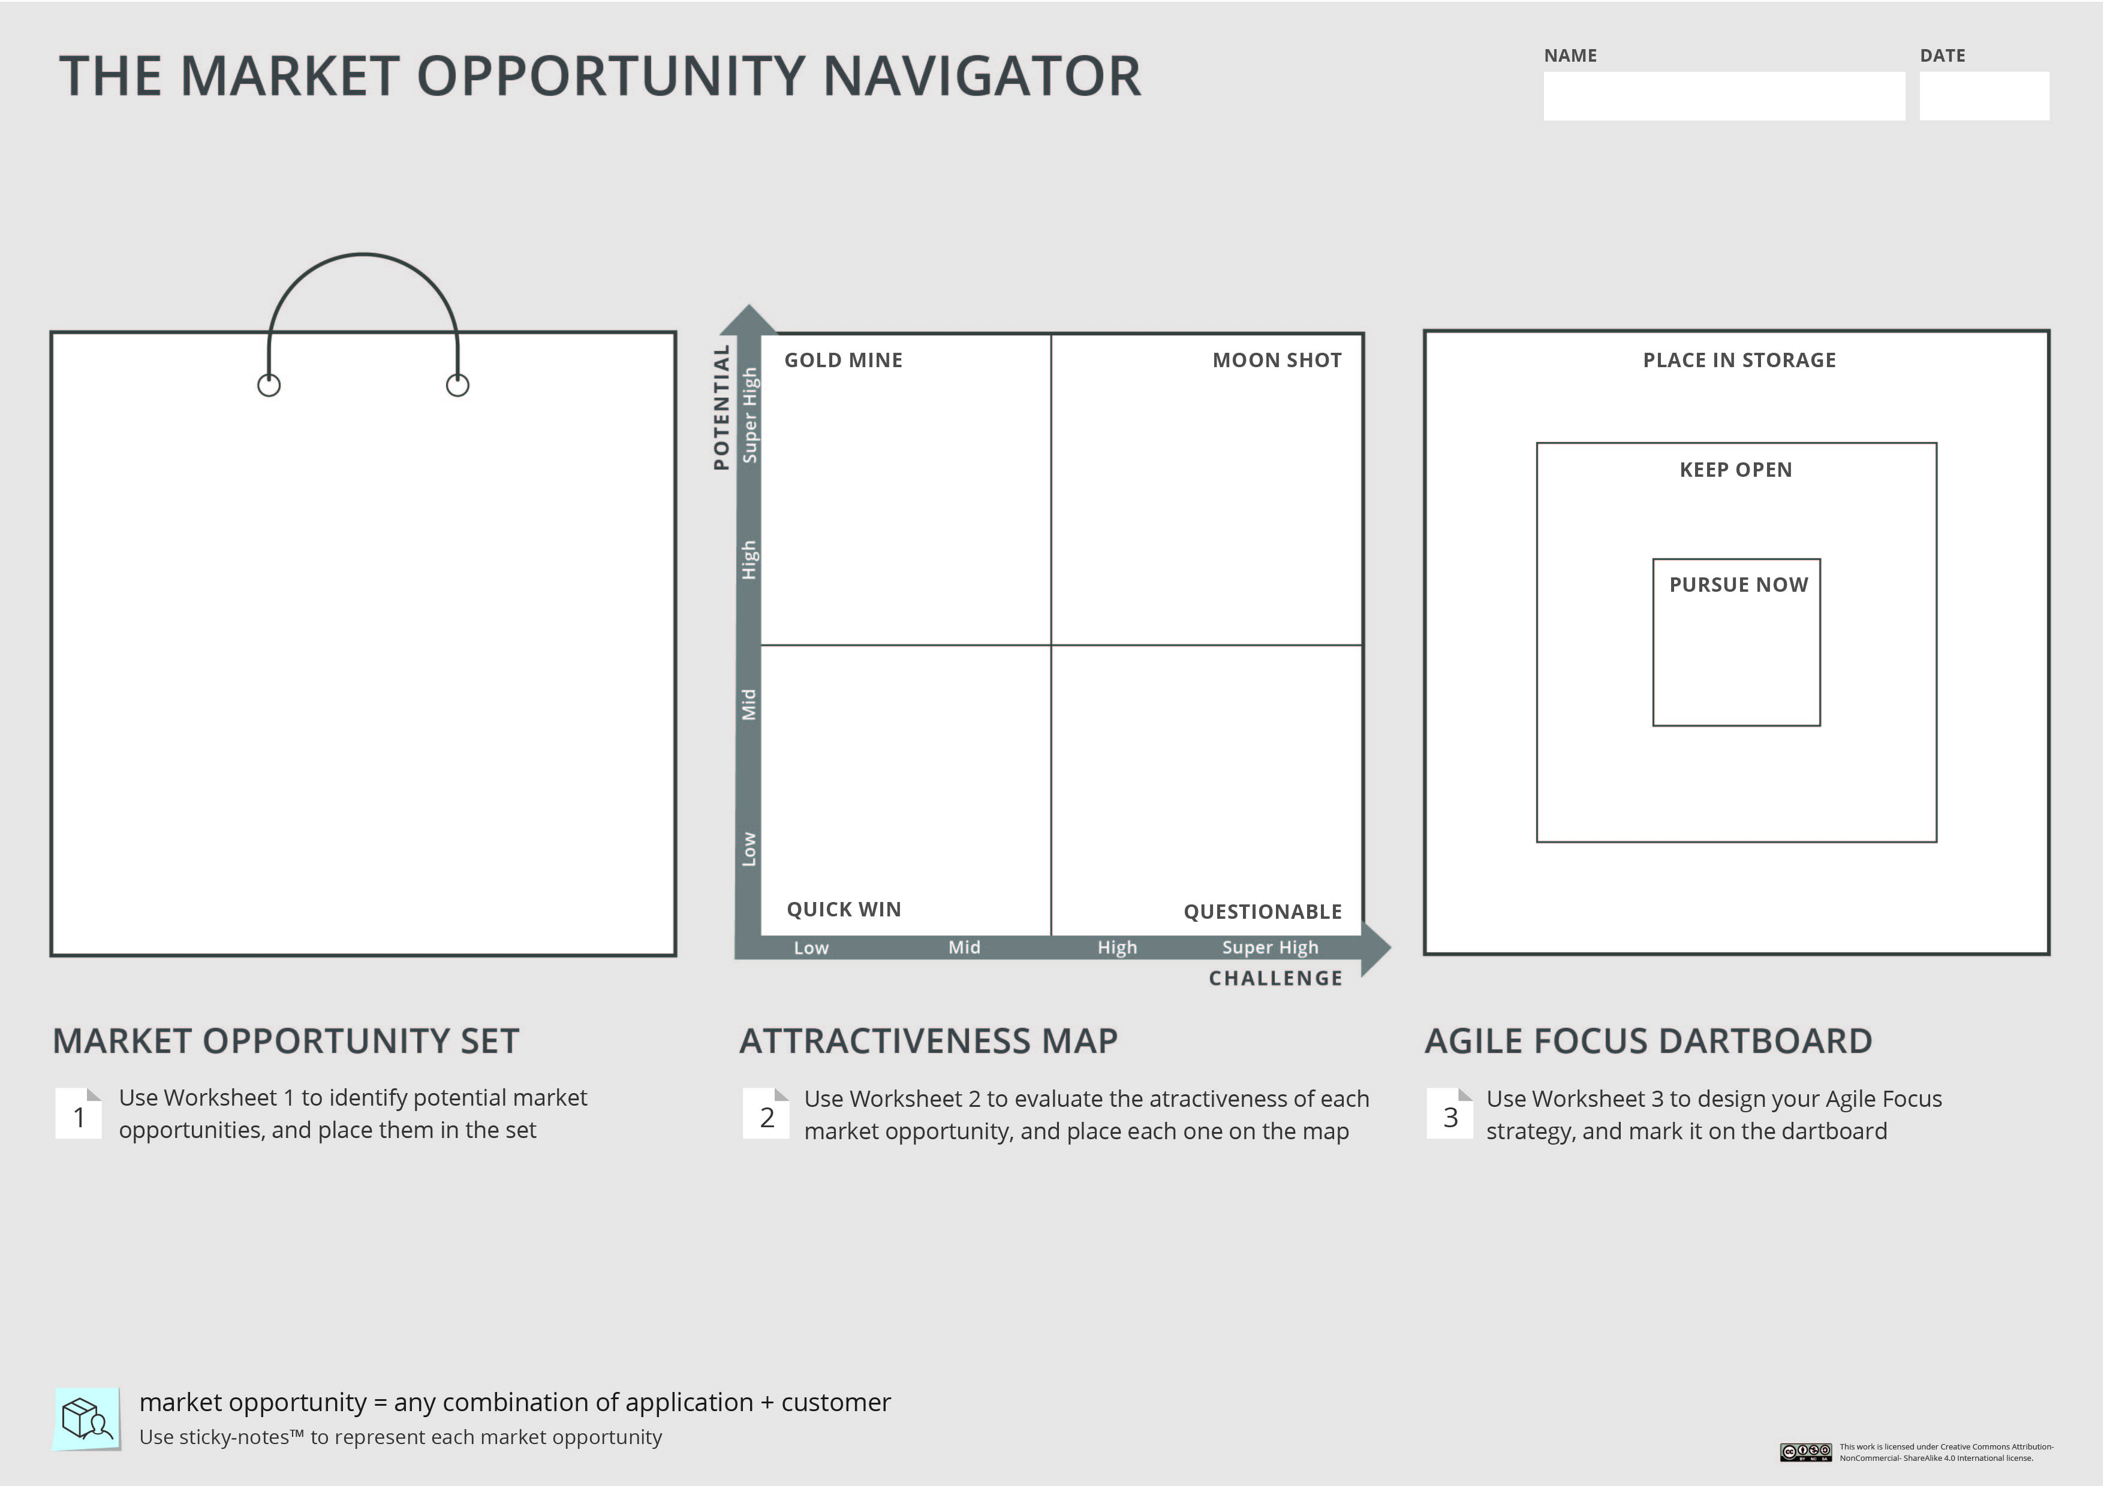
Instructions:
As a background , depict your Market Opportunity Set and your Attractiveness Map on the Navigator.
Your project/ startup

Slide 2
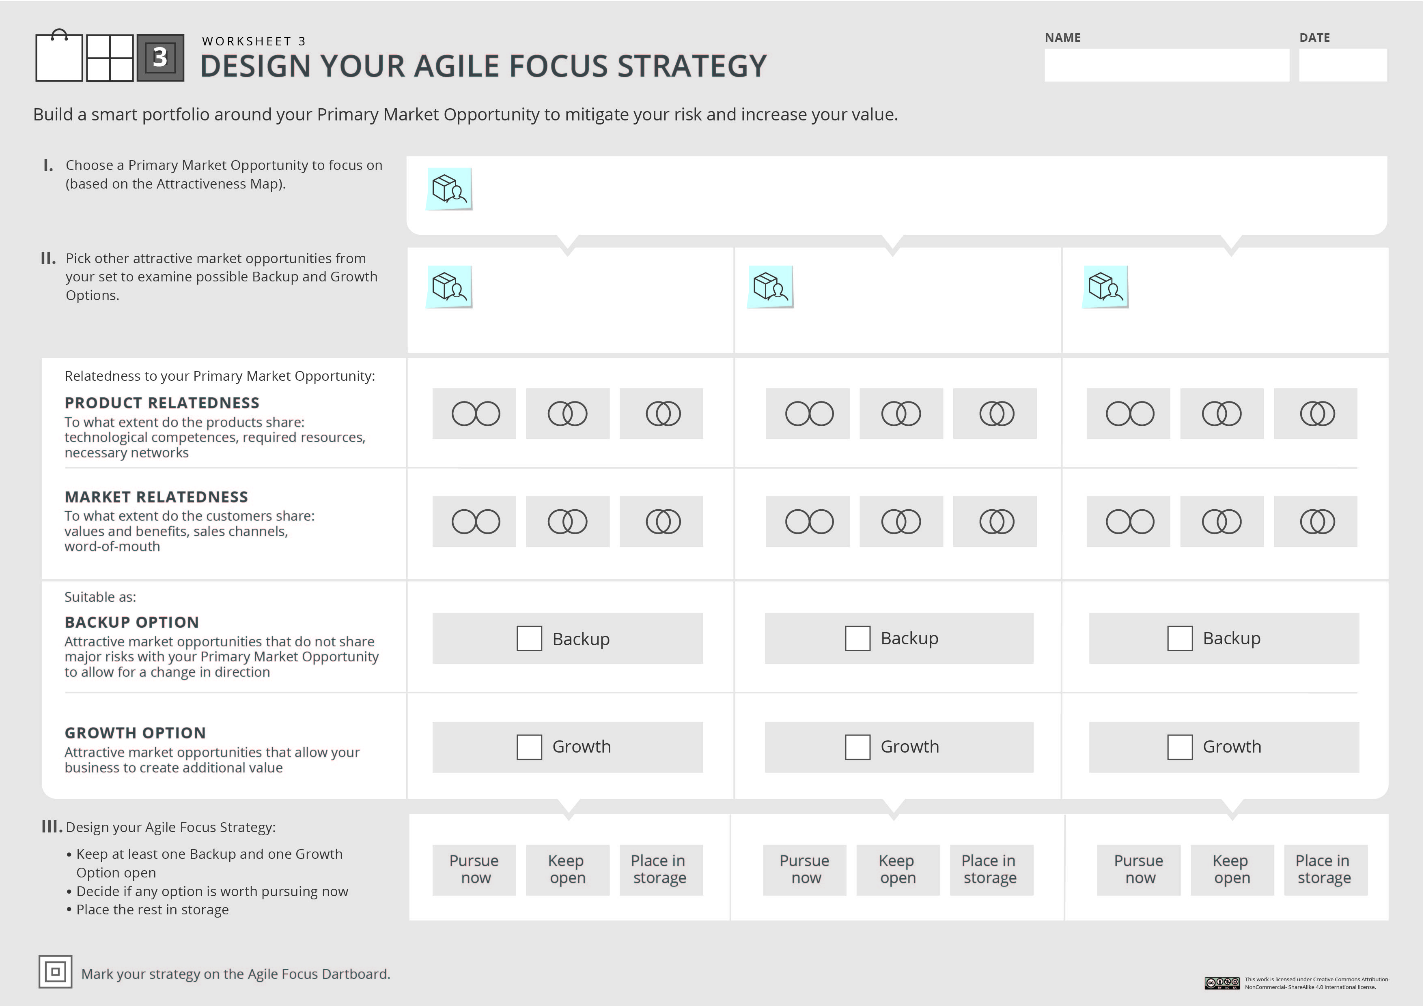


Your project/ startup
Instructions:
Fill in Worksheet 3: list your primary opportunity, and examine possible candidates for backup and growth. Make sure to keep at least one backup and one growth option open.
If you wish to consider more than 3 options, use an additional worksheet.
You can use the circles and V signs below to mark your analysis.

Slide 3
Instructions:
Fill out the last step of the Navigator- depict your Agile Focus Strategy on the Agile Focus Dartboard.
You can use the sticky notes below.
Your project/ startup

